Slide 1
Exploratory Data Analysis
EDA
Industry Dataset Analysis using Python, Pandas, Matplotlib and Seaborn

Slide 2
Project’s Agenda
Introduction
Objectives
Dataset Overview
Data preparation
Univariate Analysis
Bivariate Analysis
Multivariate Analysis
Findings
Recommendations
Conclusion

Slide 3
Introduction
EDA is performed to understand the structure, distribution, and relationships within the dataset before modeling or decision making.
Project’s Objectives:
Understand data characteristics
Detect patterns and trends
Compare Industries
Identify relationships among variable
Generate business insights

Slide 4
Data preparation
Imported dataset into Pandas Data Frame
Checked data types
Checked missing value
Verified data consistency
Prepared data for visualization

Slide 5
Univariate
Histograms and summary statistics were used to analyze individual numerical variables such as revenue, profit margin, employee count and ratings.
Profit Margin vs Industry:
Boxplot analysis –
No major outliers found.
Annual Revenue vs Industry:
Finance shows slightly outwards.

Slide 6
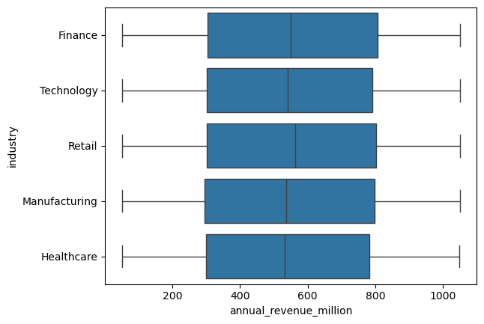
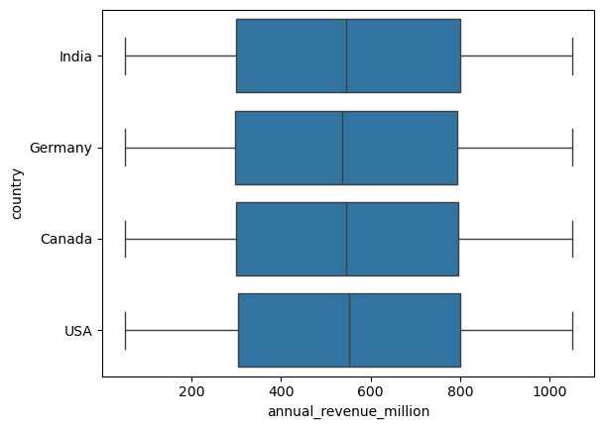
Boxplot analysis

Slide 7
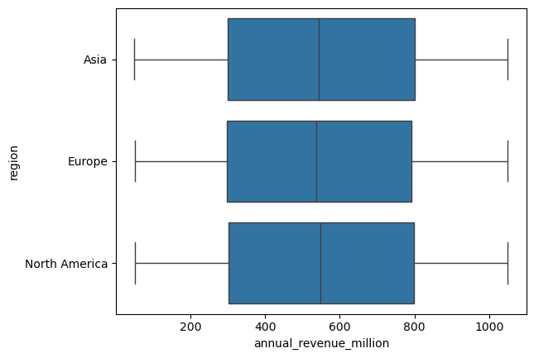
Boxplot analysis

Slide 8
Multivariate Analysis
Correlation heatmap was used to evaluate relationships among numerical variables simultaneously.
Findings of correlation heatmap:
Weak relationship among variables
no strong positive or negative correlations
Industries have similar profit margin
No significant multicollinearity

Slide 9
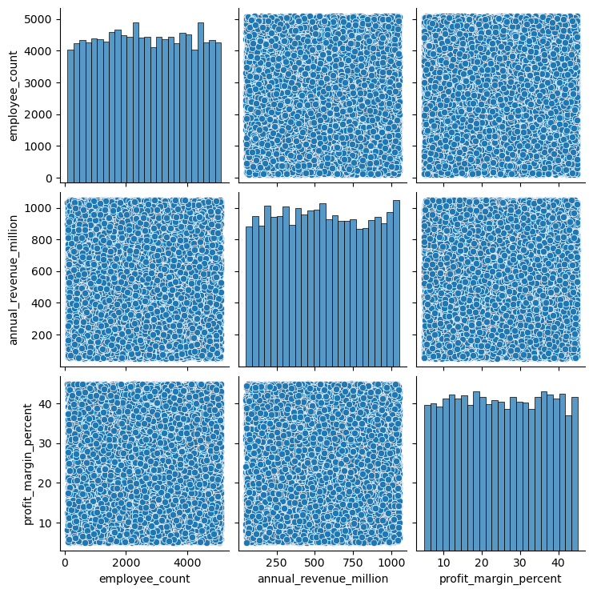
Multivariate:
These are:
1. Pair Plot
2. Correlation Heatmap

Slide 10
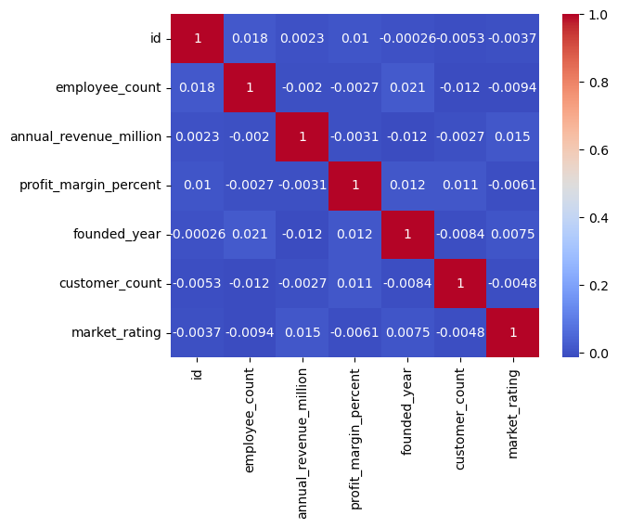
Correlation Heatmap:

Slide 11
Key Findings:
Industries have similar profit margins.
Industries have similar revenue distributions.
Dataset contains limited variation across sectors.
No significant multicollinearity.
BUSINESS INSIGHTS:
The analyzed variables appear largely independent. Industry alone does not strongly explain differences in revenue of profitability within this dataset.

Slide 12
Recommendations:
Collect additional business variables.
Increase sample size
Include growth metrics and operational KPIs.
Perform predictive analytics in future studies.
CONCLUSION:
EDA successfully summarized the dataset and revealed that most variables have weak relationships while industry – level distributions remain similar.

